Slide 1

Automated Insurance Claims with Smart Contracts
School of Computer Science and Engineering
BY TORAN V ATHANI
(21BCE2405)

Slide 2
Contents
Introduction
Application Domain Details
Use Case Details
Problems Identified
Proposed Architecture/Workflow/Methodology
Hardware and Software Requirements

Slide 3
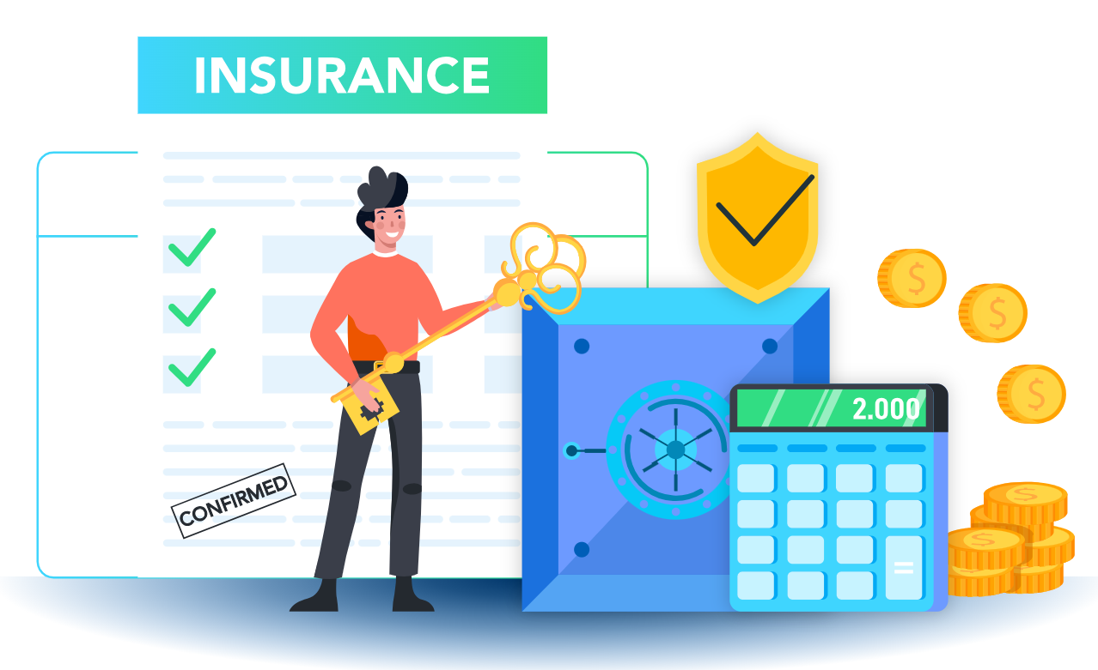

Slide 4
INTRODUCTION
Objective: Enhance insurance claim processing by leveraging smart contracts on a blockchain.
Benefits:
Automation: Reduces manual intervention by automating the claim process.
Efficiency: Speeds up claim processing and reduces administrative overhead.
Fraud Reduction: Minimizes opportunities for fraudulent claims through transparent and immutable records.
Transparency: Provides clear visibility into the claim status and process, ensuring trust between parties.

Slide 5
Application Domain Details
Domain: Insurance Industry
Overview: The insurance industry encompasses various types of insurance including health, life, auto, and property insurance. It involves the assessment, processing, and settlement of insurance claims.
Relevance: Automation in Insurance Claims:
Streamlining Processes: Automation reduces manual intervention in the claims process, speeding up claim processing and reducing errors.
Consistency: Automated systems ensure that claims are processed according to predefined rules and regulations.

Slide 6
Blockchain Technology :
Decentralization: Blockchain provides a decentralized ledger that enhances data integrity and security.
Immutability: Once data is recorded on the blockchain, it cannot be altered, which helps in preventing fraud.
Smart Contracts :
Self-Execution: Smart contracts automatically execute and enforce the terms of an agreement without the need for intermediaries.
Transparency: All transactions are recorded on the blockchain, providing clear and accessible records.

Slide 7
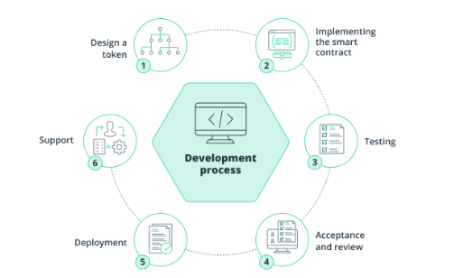

Slide 8
USE CASE DETAILS
.
Scenario: Automated processing of insurance claims
Actors: Insurance companies, claimants, and third-party verifiers
Process: Claim submission by the user, Verification of claim details using smart contracts, Automated approval/rejection based on pre-defined conditions disbursement of claim amount.

Slide 9

PROBLEMS

Slide 10
PROBLEMS IDENTIFIED
Manual Processing Issues: High error rates, long processing times
Fraud: Difficulty in verifying the authenticity of claims
Transparency: Lack of visibility into the claim status and process
Cost: High administrative costs associated with claim handling

Slide 11
Proposed Architecture/Workflow/Methodology
Architecture Overview :
Smart Contracts: Self-executing contracts with the terms directly written into code
Blockchain: Decentralized ledger to record all transactions and claims
Oracles: Third-party services to provide external data to the smart contract
Workflow :
Claim Submission, Data Validation via Oracles, Smart Contract Execution, Automated Approval/RejectionPayment Disbursement
Methodology:
Agile development with iterative testing and feedback

Slide 12
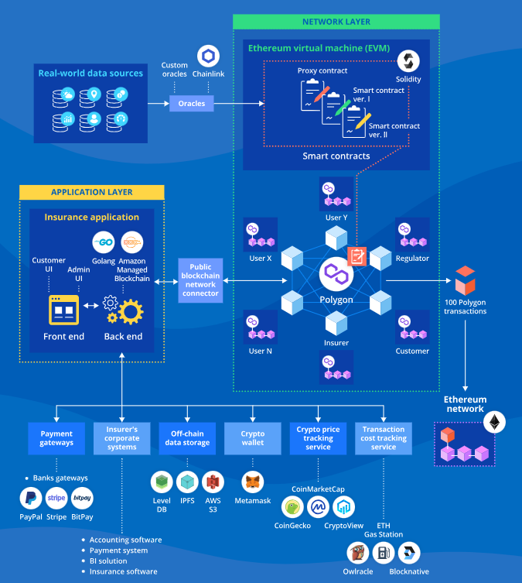

Slide 13
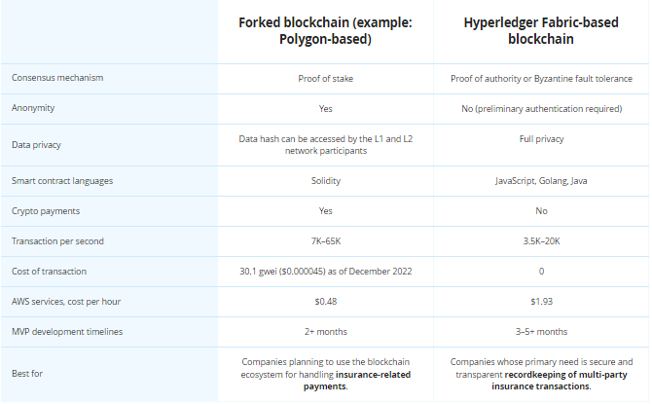

Slide 14
Hardware and Software Required
Hardware:
Servers: For hosting the blockchain nodes and smart contracts
Workstations: For development and testing
Software:
Blockchain Platform: Ethereum, Hyperledger, or other suitable platforms
Smart Contract Development Tools: Solidity (for Ethereum), Truffle Suite, Remix IDE
Database: For storing claim data, if needed
Development Environment: Node.js, JavaScript, Python, etc.
APIs: For integration with external data sources (oracles)

Slide 15
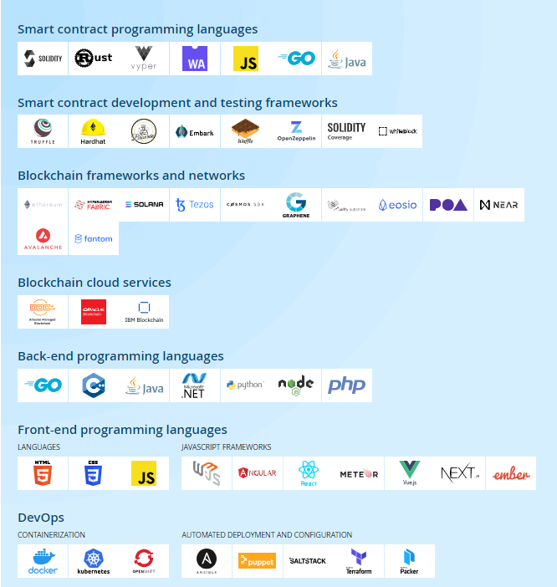

Slide 16
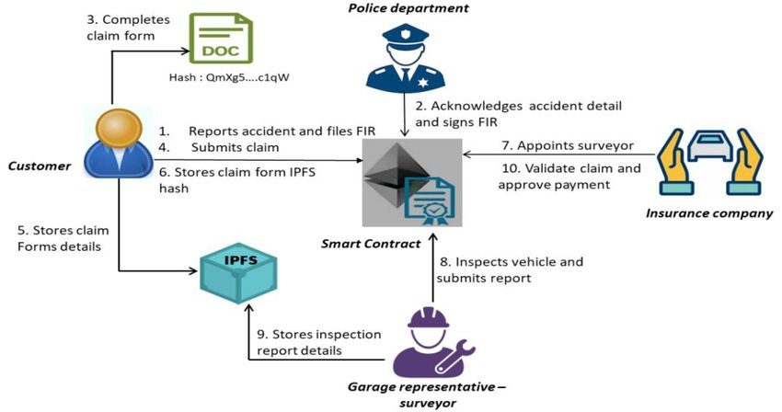
APPLICATION

Slide 17
Summary
Transformation Through Automation: Automated insurance claims using smart contracts can significantly enhance efficiency by reducing manual processes and processing times.
Blockchain Benefits: The use of blockchain technology ensures data integrity, security, and transparency, addressing common issues such as fraud and lack of visibility.
Smart Contracts: These enable automatic execution and enforcement of claims, improving consistency and reducing administrative overhead.

Slide 18


